Slide 1

DriverPass System Analysis Kyrstie Jackson 4/17/2025
A Streamlined System to Support Students, Instructors, and Administrators
Hello and thank you for joining. Today I’ll be walking you through the design of the DriverPass system—a user-friendly platform built to help students prepare for their driving exams while allowing instructors and staff to manage everything efficiently."
Notes:
[No speaker notes required for this slide.]

Slide 2

System Requirements Our system is designed to be flexible and easy to use. Whether a student is studying from home or scheduling a test, they can do it all from any device. Instructors and staff can log in securely and manage their tasks in real time.
Web-based system accessible on phones, tablets, and computers
Secure logins for students, instructors, and administrators
Practice test and learning module features
Scheduling tools for driving tests
Real-time progress tracking
Notes:
[In your speaker notes, include an explanation of the different requirements you determined for DriverPass’s system. What are the functional requirements you selected to describe? What are the nonfunctional requirements you selected to describe? Be sure to explain how these requirements meet DriverPass’s needs.]

Slide 3
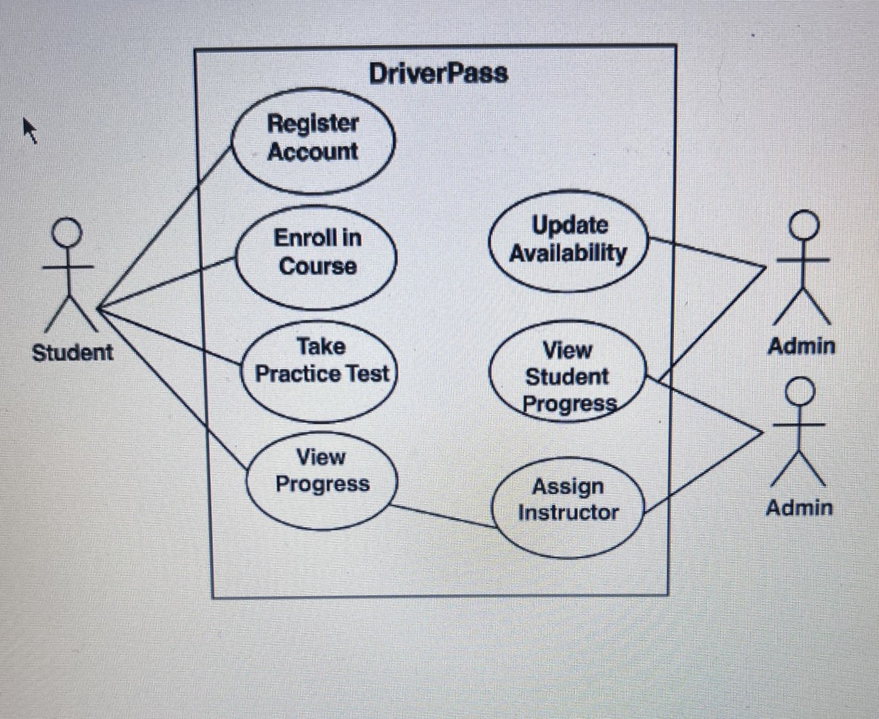
Use Case Diagram System Overview of Key User Actions This diagram gives a big-picture view of what users can do in the system. Students can enroll in courses, take practice tests, and schedule driving exams. Instructors and admins have their own tools for managing lessons and reviewing student progress.
Notes:
[Explain your diagram. Who are the different actors in the system? What are the different use cases? How did you account for DriverPass’s needs in your design? In your explanation, keep your audience in mind. Avoid the use of terms like “actors” and “use cases” in your explanation.]

Slide 4
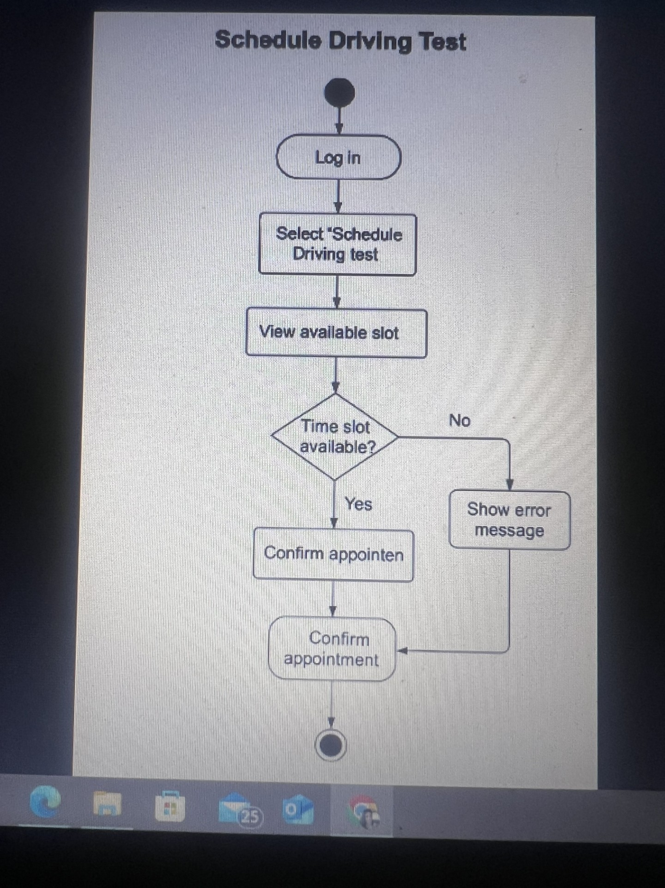
Activity Diagram How Scheduling a Driving Test Works
This shows the step-by-step flow of how a student schedules a driving test. It starts with logging in, choosing a time, and confirming availability. The system checks if the instructor is free, and then sends a confirmation."
Notes:
[Explain your diagram. Which use case are you breaking down? What are the steps for this use case? How did you account for DriverPass’s needs in your design? In your explanation, keep your audience in mind. Avoid the use of technical terms such as “nodes,” “control flows,” and so on.]

Slide 5
Security Security is a top priority. Every user has a secure login, and the system ensures that personal info is protected. We also have regular backups to keep everything safe in case of unexpected issues."
Secure login with role-based access (students, instructors, admins)
Encrypted data transfer (HTTPS)
Daily data backups
Role restrictions to protect sensitive data
Notes:
[How did you consider security in your design? In your explanation, keep your audience in mind by avoiding the use of technical terms.]

Slide 6
System Limitations While the system is designed to be highly functional, it does rely on a stable internet connection and modern devices. Admin approval is also required for actions like changing instructor assignments to keep everything organized.
Internet connection required
Admin approval needed for certain changes
Not designed for offline use
Some browser features may be limited on older devices
Notes:
[What are the limitations of your design? In your explanation, keep your audience in mind by avoiding the use of technical terms.]

